Slide 1
Tensor and Flow
-Summary
-Summary
-Summary
Jack Wu

Slide 2
Introduction
In this lecture we will be talking about TensorFlow: Tensor and Flow.
We will talk about what is Tensor, and what it means to “let tensor flow”.

Slide 3
Tensor
What is “tensor”…anyways? And some linear algebra.

Slide 4
What is Tensor?
The mathematic definition for Tensor is complicated, but it all have to do with vectors.
Tensor has different dimensions, but just remember that the idea of “Tensor” includes “Value, Vector, and Matrix”.
Read More: How Wikipedia defines “Tensor”: https://en.wikipedia.org/wiki/Tensor

Slide 5
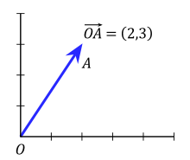
Vector
Vector: An element of a vector space.
The idea of “space” means a space that contains all the vector of the same dimension. For example, a 2 dimension vector space contains all the 2D vectors, like (2,3), (0,0), (0.5,2.5).
Value is a One-Dimension Vector.
(1, 9, 2.608, 17) is a 4-Dimension vector. It belongs to a 4 dimension vector space.

Slide 6
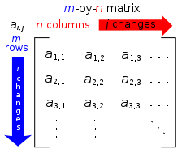
Matrix
Matrix is a rectangular array of numbers, constructed by vectors.
A m-by-n matrix can be viewed as a matrix constructed by m n-Dimension vectors, or as a matrix with n m-Dimension vectors, depends on how you view them.

Slide 7
Visualize Tensor
Tensor
Matrix (2+ Dimension Tensor)
[1 2 3 4]
[5 6 7 8]
[9 8 7 6] is a 3-by-4 Matrix, and a 3 Dimension Tensor.
1
Vector(1 Dimension Tensor, but can have n Dimension as a vector)
(1, 9, 2.608, 17) is a 4 Dimension Vector
3.1415926
Value (0 Dimension Tensor, 1 Dimension Vector)

Slide 8
Flow
Now I know what a Tensor is, so what?

Slide 9
Flow like a Traveler
Imagine you are in Japan alone knowing zero Japanese.
Now you want to get Sushi, and you know a really good Sushi place somewhere near by, so you pull up the address from your phone.
You can’t speak Japanese, so you show the address to a taxi driver.
The taxi driver pulls out a map on his phone, and the map gives directions to the restaurant. The driver then follow that direction and you get Sushi for dinner.

Slide 10
TensorFlow like a Traveler
TensorFlow uses the same kind of idea. In order to allow TensorFlow run on different platforms and APIs, all the code need to construct a “computational graph”. This works like a map to give directions to TensorFlow.
Now imagine TensorFlow is the traveler, and the task “go to the sushi restaurant” is our desired output, and the computational graph is the map that gives directions. The address is what humans want the program to accomplish, and the ride to the sushi restaurant is program execution.

Slide 11
Travel with TensorFlow
Imagine you are TensorFlow alone knowing nothing about what human want to do.
Now the human want to get a task done, and the human knows what the algorism is, so the human writes code from IDE software.
Human cannot execute code, so the human show the code to Python and run.
The algorism uses the computational map, and the map gives directions on the flow of operations, and the code implements it. The code then follow that flow of operations and the human is happy and go grab pizza and coffee.

Slide 12
Visualize the Flow
URL:
https://www.tensorflow.org/images/tensors_flowing.gif

Slide 13
END

Slide 14
UNUSED SLIDES

Slide 15
Instructions for use
EDIT IN GOOGLE SLIDES
Click on the button under the presentation preview that says "Use as Google Slides Theme".
You will get a copy of this document on your Google Drive and will be able to edit, add or delete slides.
You have to be signed in to your Google account.
EDIT IN POWERPOINT®
Click on the button under the presentation preview that says "Download as PowerPoint template". You will get a .pptx file that you can edit in PowerPoint.
Remember to download and install the fonts used in this presentation (you’ll find the links to the font files needed in the Presentation design slide)
More info on how to use this template at www.slidescarnival.com/help-use-presentation-template
This template is free to use under Creative Commons Attribution license. You can keep the Credits slide or mention SlidesCarnival and other resources used in a slide footer.

Slide 16
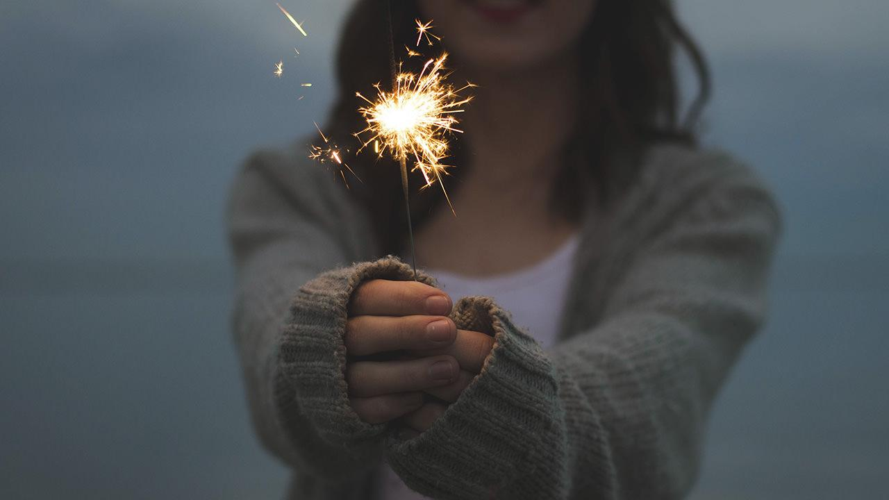
Hello!
I am Jayden Smith
I am here because I love to give presentations.
You can find me at @username

Slide 17
1.
Transition headline
Let’s start with the first set of slides

Slide 18
“Quotations are commonly printed as a means of inspiration and to invoke philosophical thoughts from the reader”

Slide 19
This is a slide title
Here you have a list of items
And some text
But remember not to overload your slides with content
Your audience will listen to you or read the content, but won’t do both.

Slide 20
Big concept
Bring the attention of your audience over a key concept using icons or illustrations

Slide 21
You can also split your content
White
Is the color of milk and fresh snow, the color produced by the combination of all the colors of the visible spectrum.
Black
Is the color of coal, ebony, and of outer space. It is the darkest color, the result of the absence of or complete absorption of light.

Slide 22
In two or three columns
Yellow
Is the color of gold, butter and ripe lemons. In the spectrum of visible light, yellow is found between green and orange.
Blue
Is the colour of the clear sky and the deep sea. It is located between violet and green on the optical spectrum.
Red
Is the color of blood, and because of this it has historically been associated with sacrifice, danger and courage.

Slide 23
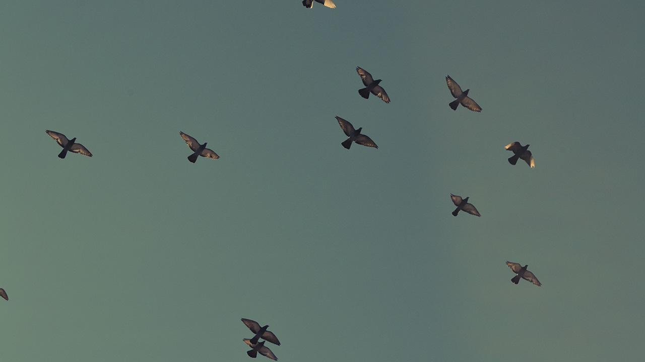
A picture is worth a thousand words
A complex idea can be conveyed with just a single still image, namely making it possible to absorb large amounts of data quickly.

Slide 24
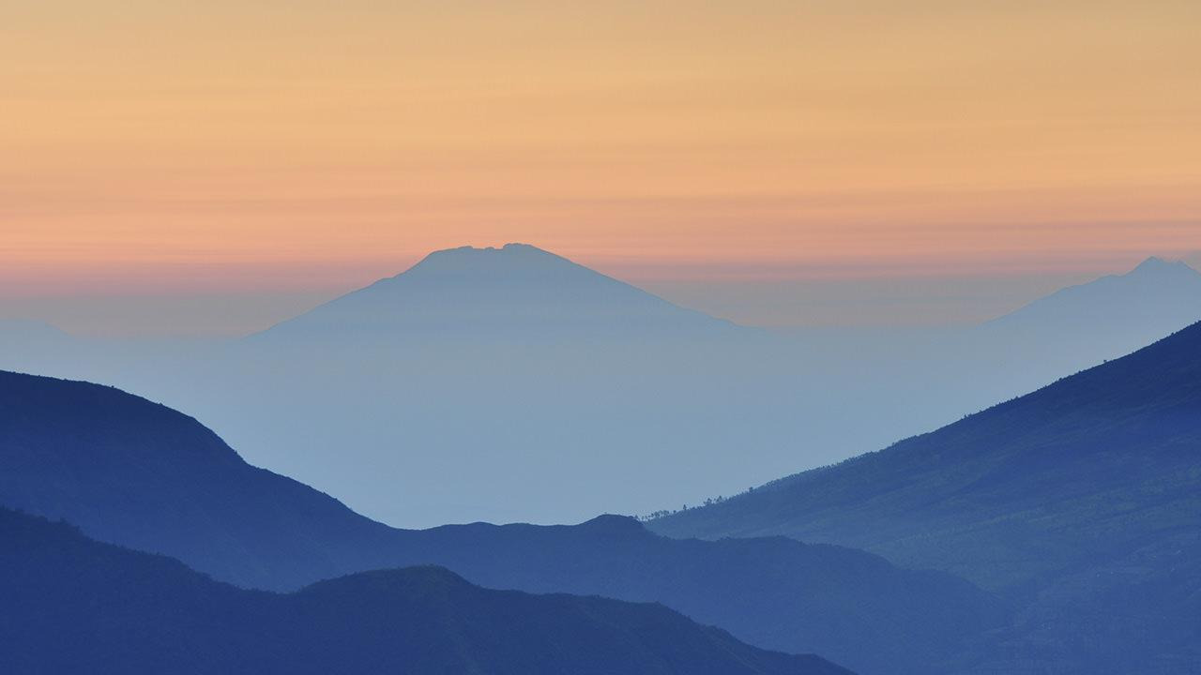
Want big impact?
Use big image.

Slide 25
Use charts to explain your ideas
White
Gray
Black

Slide 26
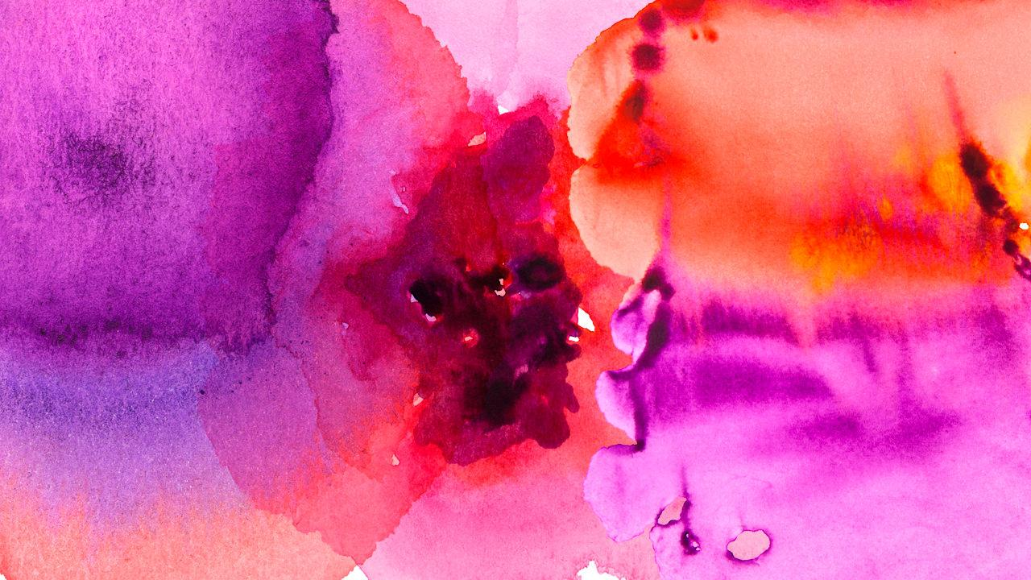
And tables to compare data
 | A | B | C
Yellow | 10 | 20 | 7
Blue | 30 | 15 | 10
Orange | 5 | 24 | 16

Slide 27
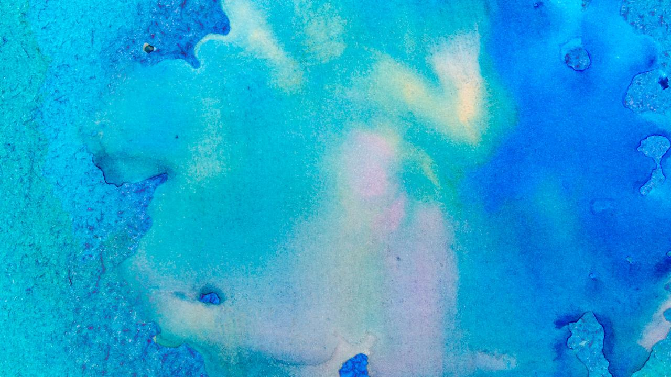
Maps
our office

Slide 28
89,526,124
Whoa! That’s a big number, aren’t you proud?

Slide 29
89,526,124$
185,244 users
100%
That’s a lot of money
And a lot of users
Total success!

Slide 30
Our process is easy
first
second
last

Slide 31
Let’s review some concepts
Yellow
Is the color of gold, butter and ripe lemons. In the spectrum of visible light, yellow is found between green and orange.
Blue
Is the colour of the clear sky and the deep sea. It is located between violet and green on the optical spectrum.
Red
Is the color of blood, and because of this it has historically been associated with sacrifice, danger and courage.
Yellow
Is the color of gold, butter and ripe lemons. In the spectrum of visible light, yellow is found between green and orange.
Blue
Is the colour of the clear sky and the deep sea. It is located between violet and green on the optical spectrum.
Red
Is the color of blood, and because of this it has historically been associated with sacrifice, danger and courage.

Slide 32
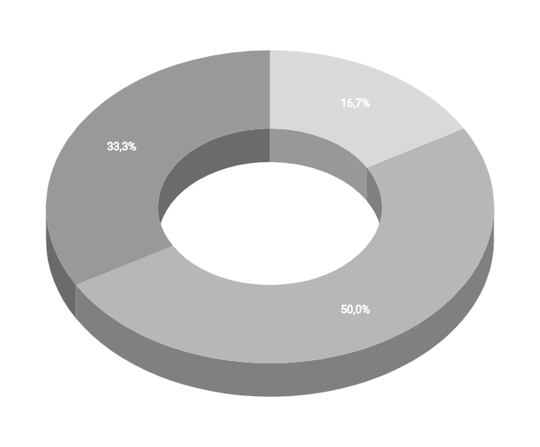
You can insert graphs from Google Sheets

Slide 33
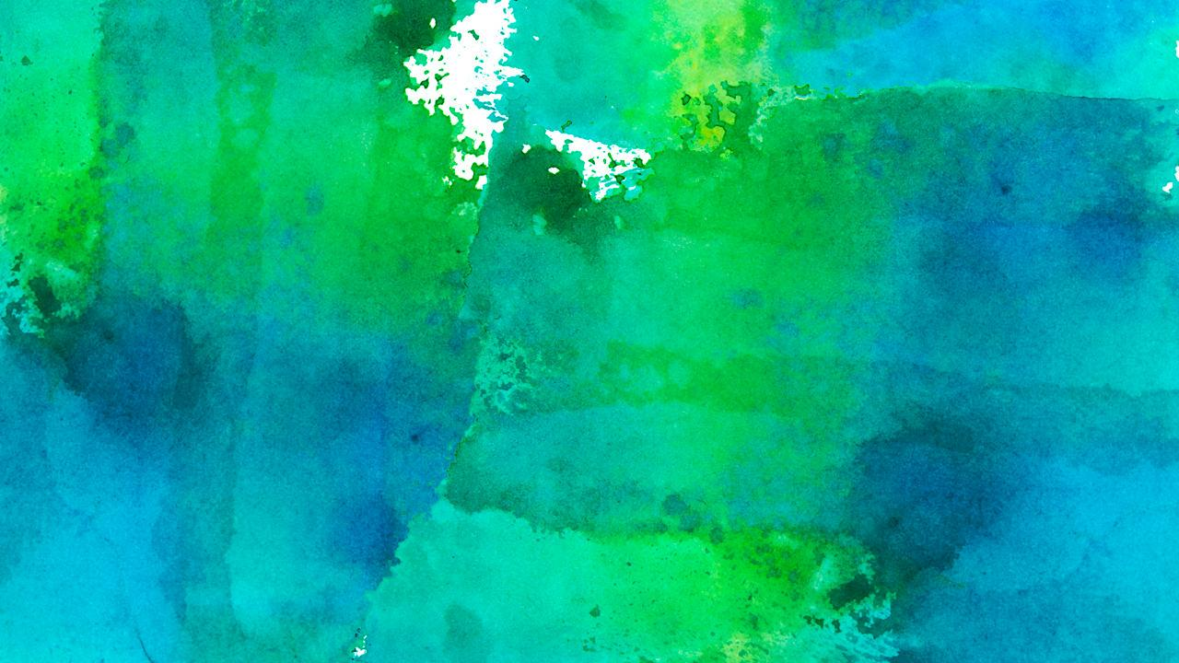
Android project
Show and explain your web, app or software projects using these gadget templates.
Place your screenshot here

Slide 34
iPhone project
Show and explain your web, app or software projects using these gadget templates.
Place your screenshot here

Slide 35
Tablet project
Show and explain your web, app or software projects using these gadget templates.
Place your screenshot here

Slide 36
Desktop project
Show and explain your web, app or software projects using these gadget templates.
Place your screenshot here

Slide 37
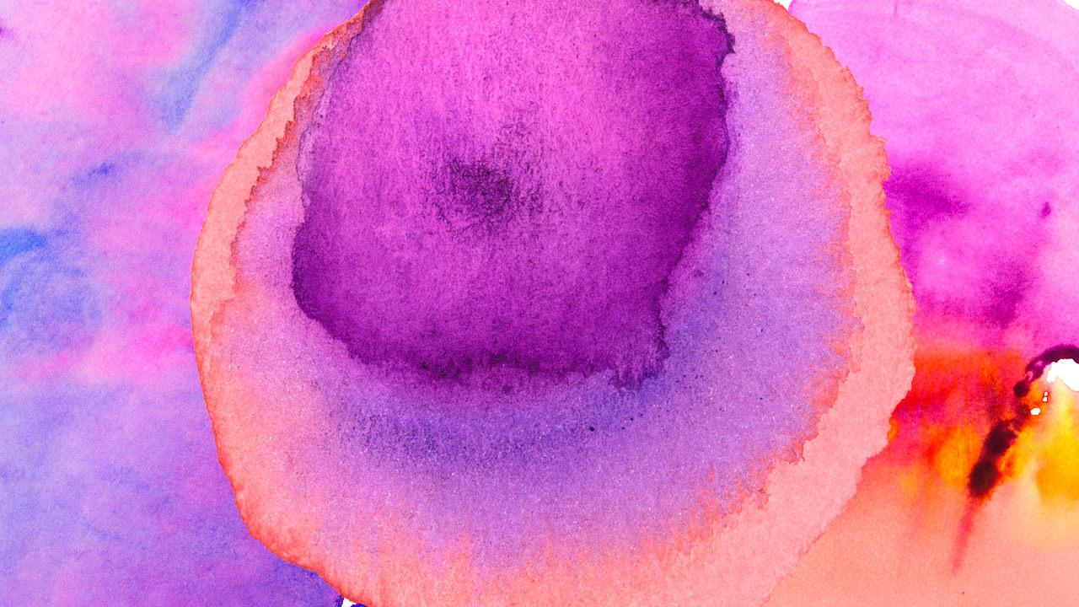
Thanks!
Any questions?
You can find me at:
@username
user@mail.me

Slide 38
Credits
Special thanks to all the people who made and released these awesome resources for free:
Presentation template by SlidesCarnival
Photographs by Unsplash
Watercolor textures by GraphicBurguer

Slide 39
Presentation design
This presentation uses the following typographies and colors:
Titles: Lato Thin
Body copy: Lato Light
You can download the fonts on this page:
http://www.latofonts.com/lato-free-fonts/
You don’t need to keep this slide in your presentation. It’s only here to serve you as a design guide if you need to create new slides or download the fonts to edit the presentation in PowerPoint®

Slide 40
SlidesCarnival icons are editable shapes.
This means that you can:
Resize them without losing quality.
Change fill color and opacity.
Isn’t that nice? :)
Examples:

Slide 41
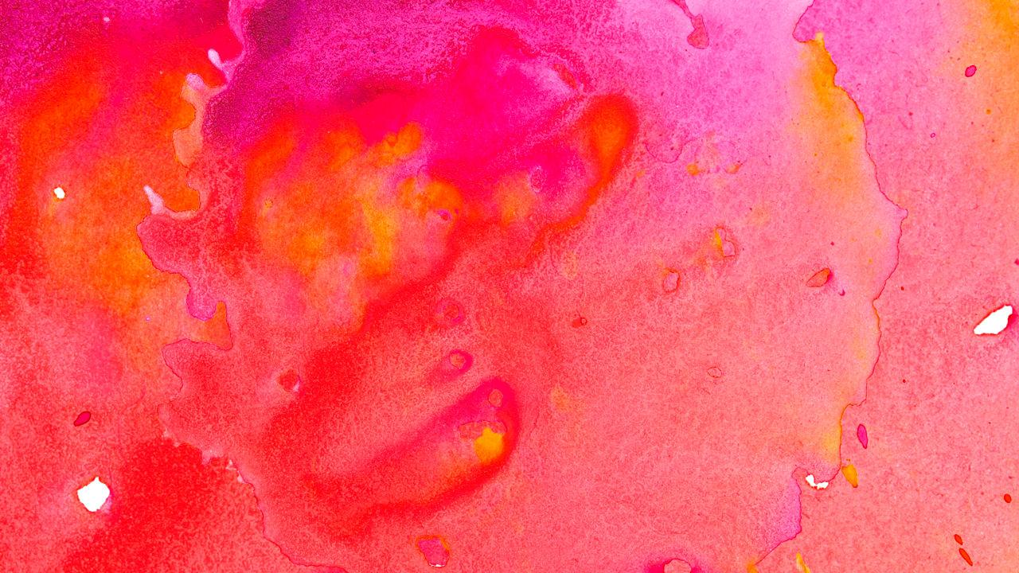
😉
Now you can use any emoji as an icon!
And of course it resizes without losing quality and you can change the color.
How? Follow Google instructions https://twitter.com/googledocs/status/730087240156643328
✋👆👉👍👤👦👧👨👩👪💃🏃💑❤😂😉😋😒😭👶😸🐟🍒🍔💣📌📖🔨🎃🎈🎨🏈🏰🌏🔌🔑 and many more...

